Slide 1
Heroic Characters in A Lesson Before Dying
1
| www.ebsco.com

Slide 2
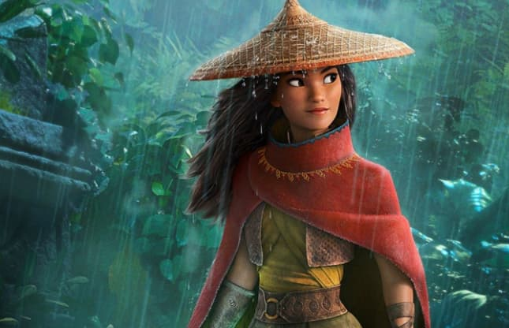
Who are these people?
Raya, the protagonist in Raya and the Last Dragon
Harry Potter and his fellow wizards, Ron and Hermione
2
| www.ebsco.com

Slide 3
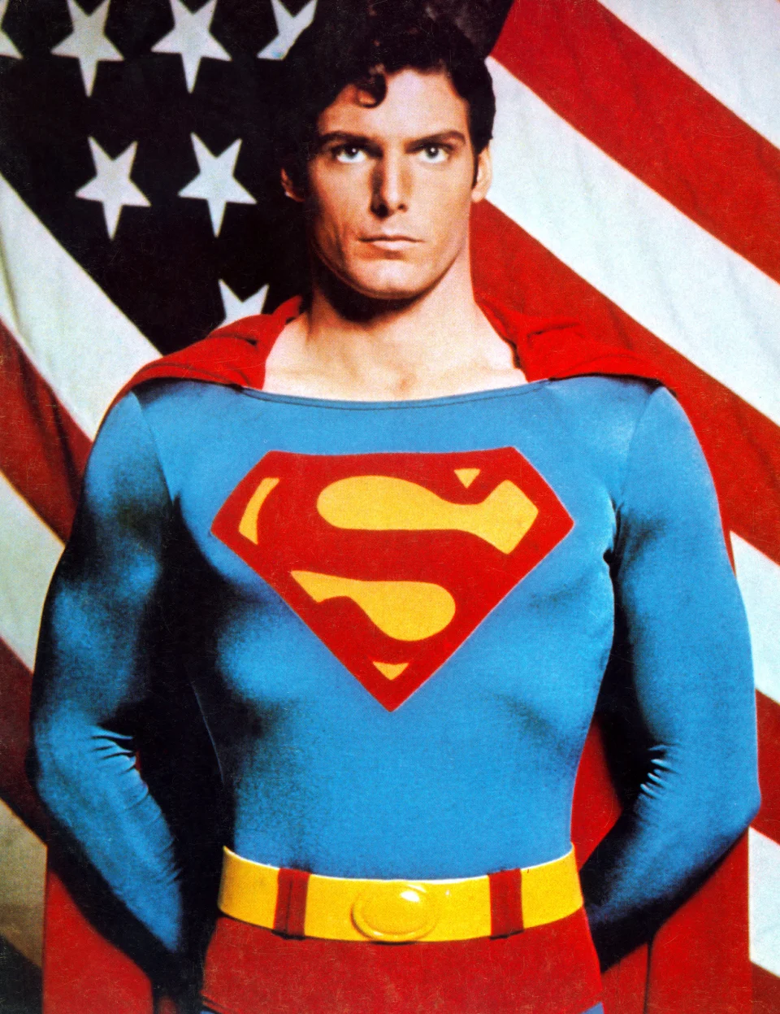
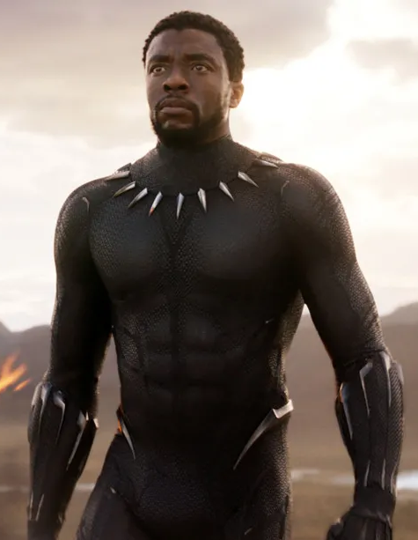
And these people?
Superman
Black Panther
Captain Marvel
3
| www.ebsco.com

Slide 4
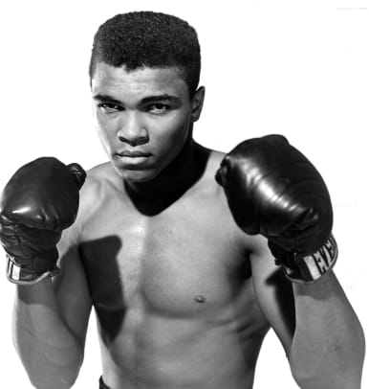
And these?
Jackie Robinson
Muhammad Ali
4
| www.ebsco.com
Notes:
Notes:
Jackie Robinson became the first African-American to play major league baseball.
Muhammed Ali became a heavyweight boxing champ three times.

Slide 5
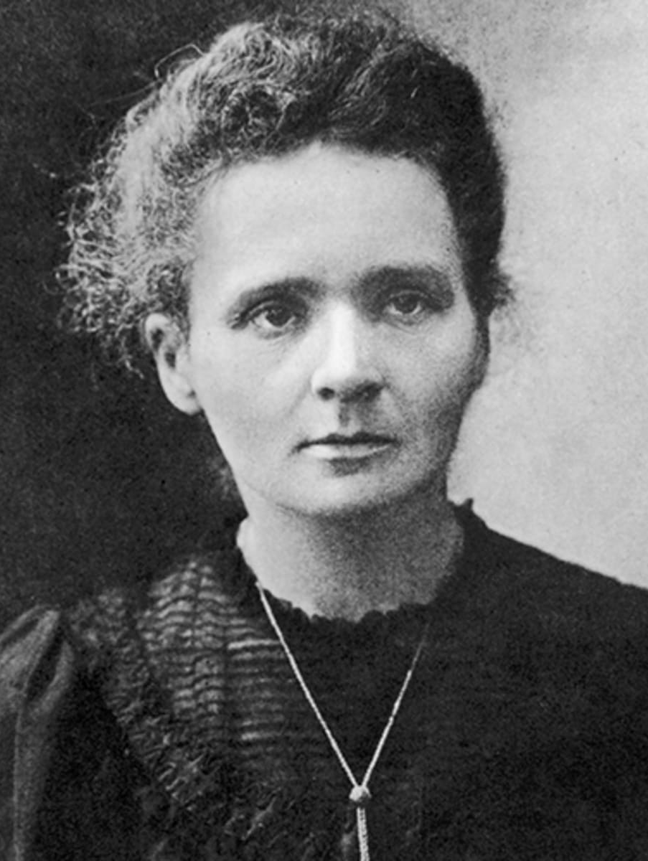
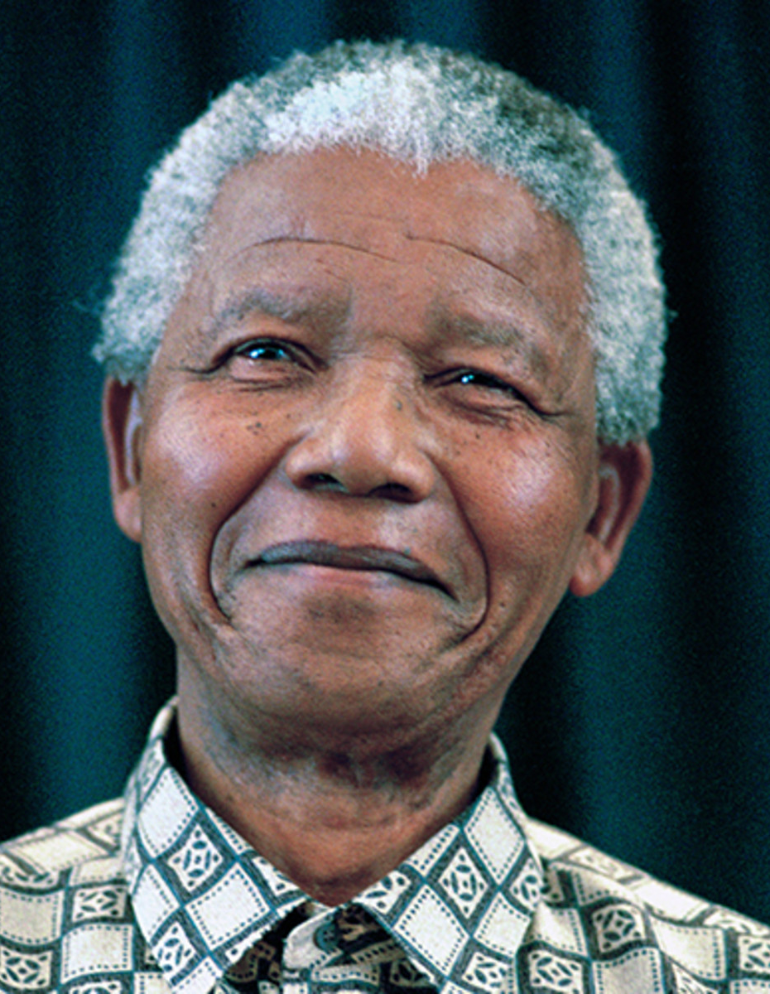
What do all these people have in common?
Marie Curie
Nelson Mandela
Malala Yousafzai
5
| www.ebsco.com
Notes:
Notes:
Marie Curie was the first woman to win a Nobel Prize, in Physics, and with her later win, in Chemistry, she became the first person to claim Nobel honors twice. Curie discovered radioactivity, and, together with her husband Pierre, the radioactive elements polonium and radium. She also championed the development of X-rays after Pierre's death. Curie died on July 4, 1934, of aplastic anemia, believed to be caused by prolonged exposure to radiation.
Nelson Mandela was a South African revolutionary who helped end the country’s apartheid system of racial segregation. After spending 27 years in prison for sabotage against the tyrannical South African regime, he served as the country’s first democratically elected president from 1994-1999.
As a young girl, Malala Yousafzai (Yoo-soff-sigh) defied the Taliban in Pakistan and demanded that girls be allowed to receive an education. She was shot in the head by a Taliban gunman in 2012 but survived. In 2014, she became the youngest person to receive the Nobel Peace Prize. Malala continues to campaign for girls’ education and women’s rights.

Slide 6
What one word describes each?
HERO
6
| www.ebsco.com

Slide 7
What qualities must a hero possess?
7
| www.ebsco.com

Slide 8
What makes an act heroic?
8
| www.ebsco.com

Slide 9
Enduring Understanding
A heroic act usually involves risk and/or sacrifice.
9
| www.ebsco.com

Slide 10
Rank from most heroic (1) to least heroic (4)
___ Gymnast recovers from paralysis to win Olympic gold medal
___ Nazi saves 1,200 Jews during Holocaust by employing them in his factories
___ School teacher dies in shuttle explosion
___ 11-year-old boy saves little girl’s life
___ Passengers of a hijacked airplane die while stopping terrorists’ plan
___ Female prison inmates in California volunteer to fight dangerous wildfires
___ Lifeguard rescues drowning boy
___ Medical staff work round the clock to save COVID-19 patients
10
| www.ebsco.com

Slide 11
Characterization
The process used by a writer to develop a character
Characterization is revealed through direct characterization and indirect characterization.
11
| www.ebsco.com

Slide 12
Direct Characterization
Direct characterization is used to introduce characters, reveal their motivations and provide the reader with memorable character traits.
Physical description (e.g., blue eyes, tall)
Job (e.g., teacher, lawyer)
Passions or pursuits (e.g., avid reader, aspiring writer)
When an author uses adjectives to tell what a character is like
12
| www.ebsco.com

Slide 13
Indirect Characterization
Use the acronym STEAL to remember the five methods of indirect characterization:
Speech
Thoughts
Effect on others
Actions
Looks (appearance)
When an author uses verbs to show what a character is like
13
| www.ebsco.com
Notes:
Speech: What does the character say? How does the character speak?
Thoughts: What is revealed through the character’s private thoughts and feelings?
Effect on others: What effect does the character have on other people? How do the other characters behave in reaction to the character?
Actions: What does the character do? How does the character behave?
Looks (appearance): What does the character look like? How does the character dress?

Slide 14
Who is more heroic? Grant or Jefferson? Why?
In class: Discuss in small groups whether Grant Wiggins or Jefferson is the more heroic character in A Lesson Before Dying. Find examples of direct and indirect characterization to support your assertion.
At home: Determine which character you believe is more heroic and write a well-developed open response essay that supports your assertion. Be sure to include 2-3 specific details from the text.
14
| www.ebsco.com

Slide 15
Image Sources
https://www.cnbc.com/2021/03/02/raya-and-the-last-dragon-reviews-what-critics-are-saying.html
https://www.forbes.com/sites/emmapocock/2020/07/21/all-eight-harry-potter-films-will-leave-hbo-max-in-august/?sh=5819e347735b
https://sg.finance.yahoo.com/news/superman-movie-turns-40-christopher-reeve-still-best-man-steel-140019373.html
https://www.vox.com/culture/2018/12/11/18119694/black-panther-success-2018-marvel
https://www.harpersbazaar.com/culture/film-tv/a26767181/captain-marvel-review/
https://www.latimes.com/sports/dodgers/la-sp-dodgers-dugout-robinson-20180328-story.html
https://www.history.com/topics/black-history/muhammad-ali
https://www.biography.com/scientist/marie-curie
https://www.biography.com/political-figure/nelson-mandela
https://www.apple.com/newsroom/2021/03/apple-tv-plus-announces-programming-partnership-with-nobel-laureate-malala-yousafzai/
https://federalsoup.com/articles/2020/05/14/unions-praise-heroes-act.aspx
15
| www.ebsco.com

